Slide 1
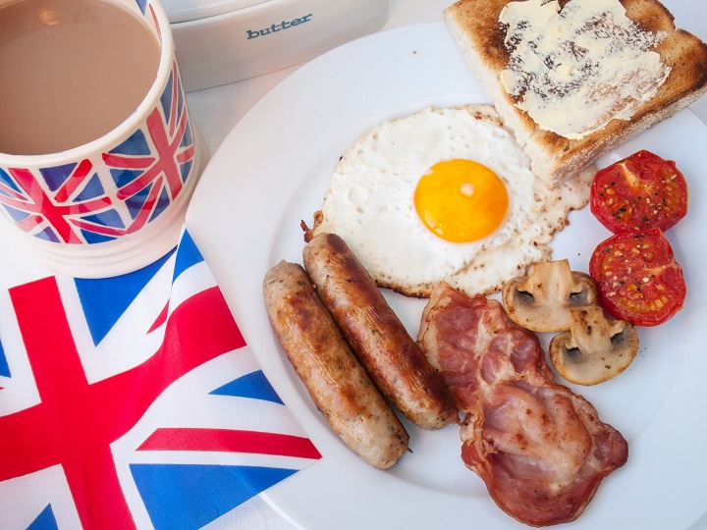
The English national cuisine

Slide 2
The Most Popular English DISHES

Slide 3
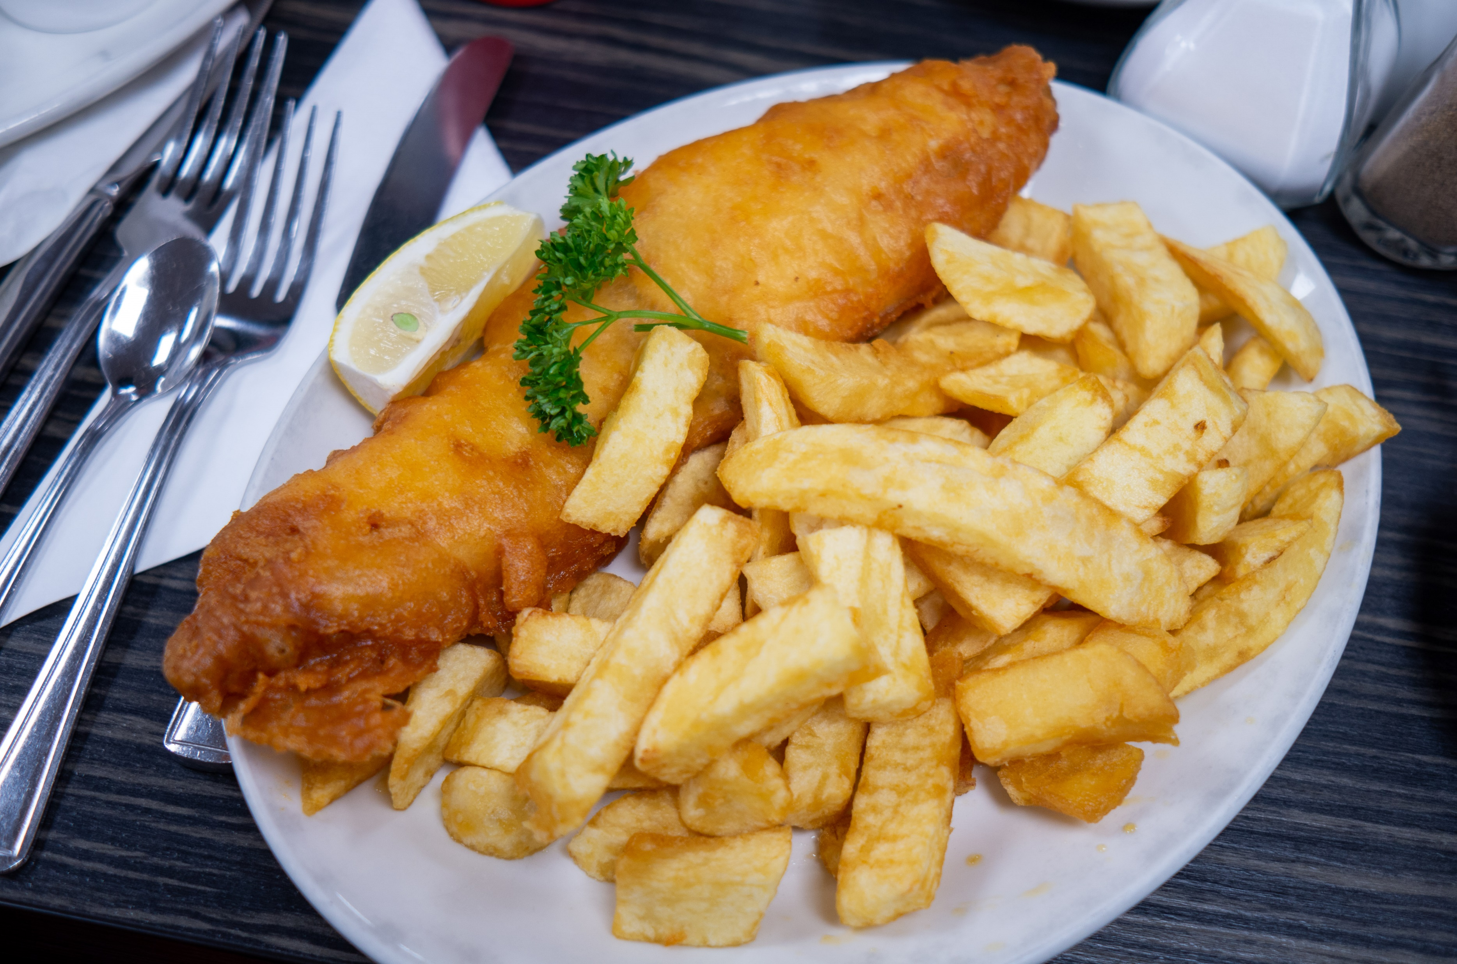
FISH AND CHIPS

Slide 4
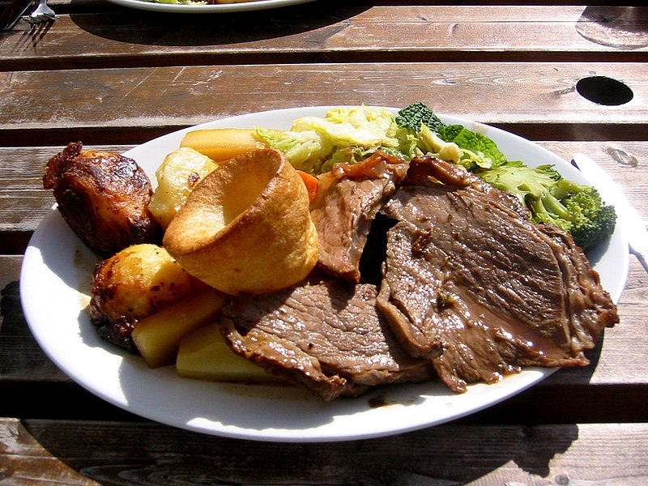
Sunday roast

Slide 5
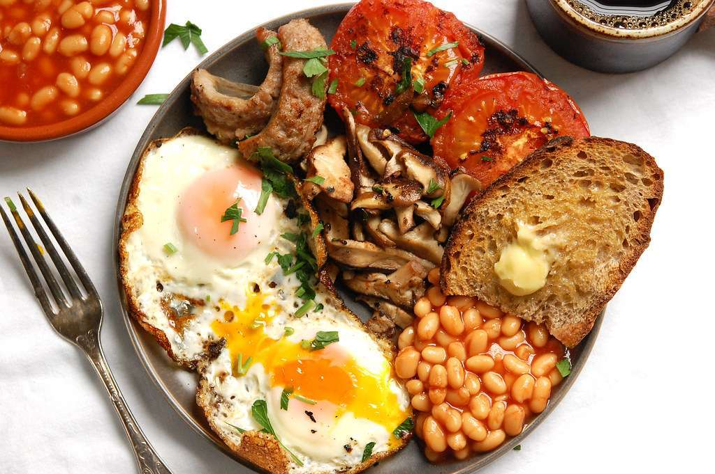
Full breakfast

Slide 6
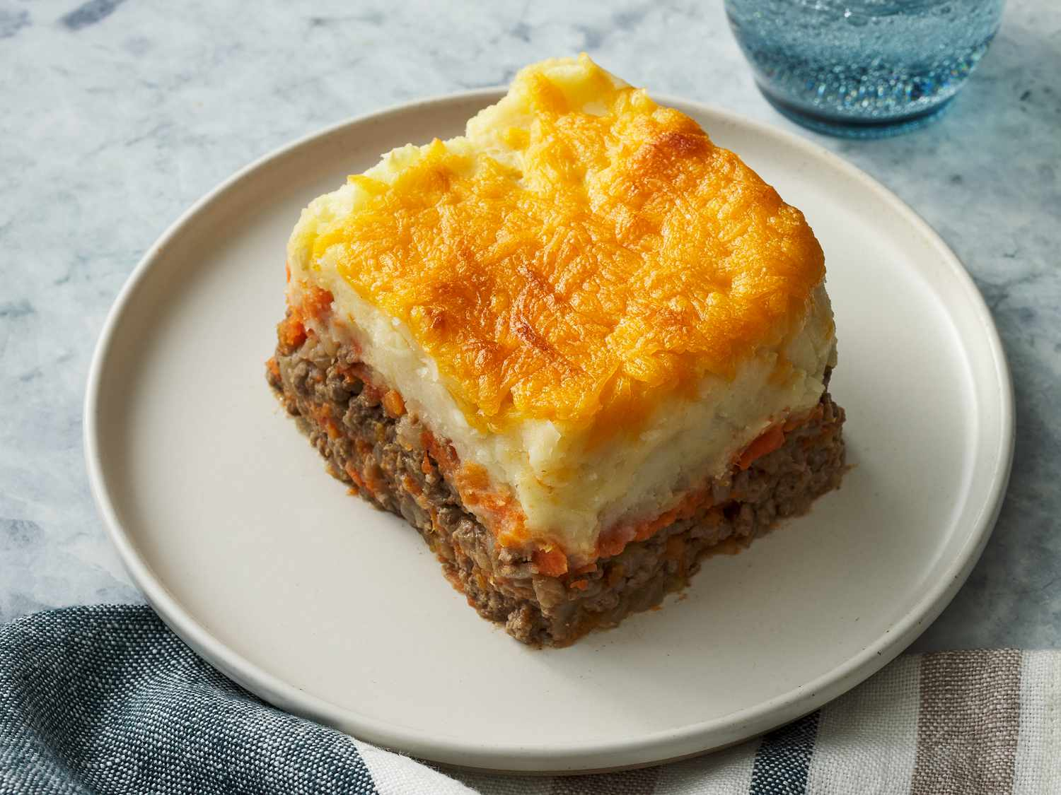
Shephard’s pie

Slide 7
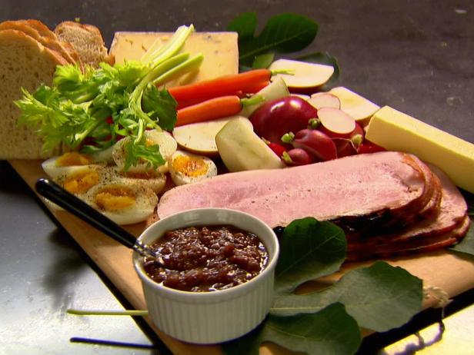
PLOUGHMAN’S LUNCH

Slide 8
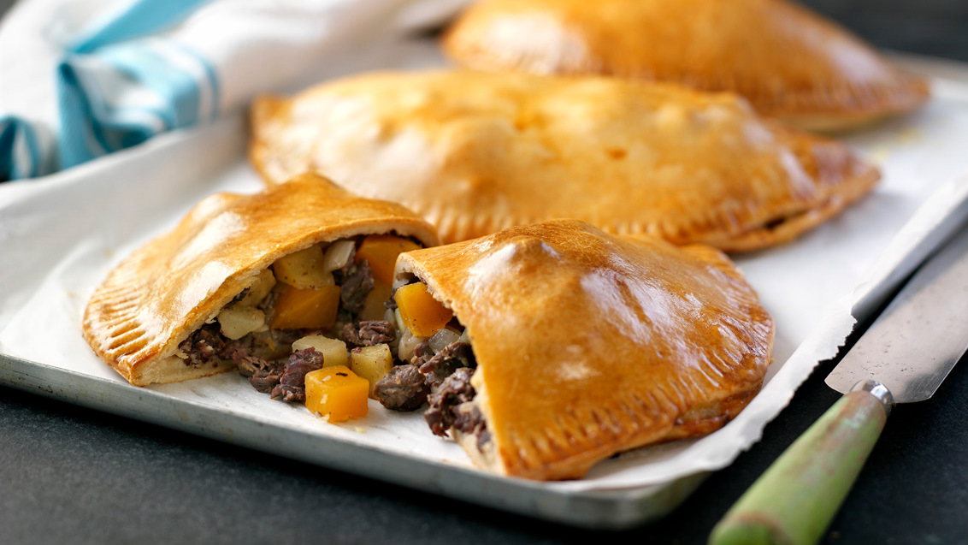
Cornish pasty

Slide 9
The most popular English drinks

Slide 10
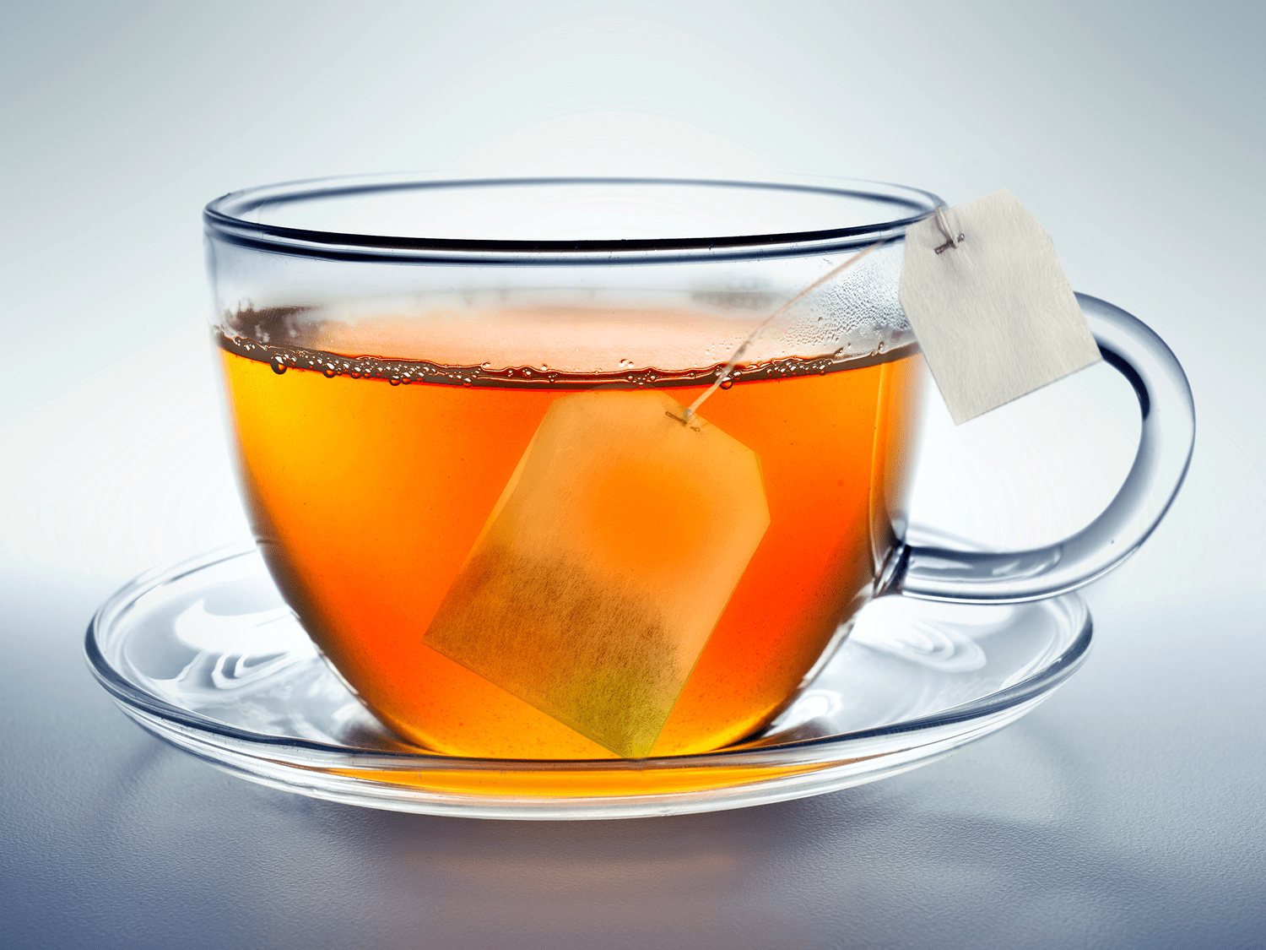
TEA

Slide 11
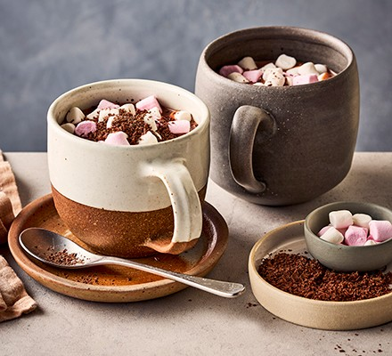
Hot chocolate with marshmallows

Slide 12
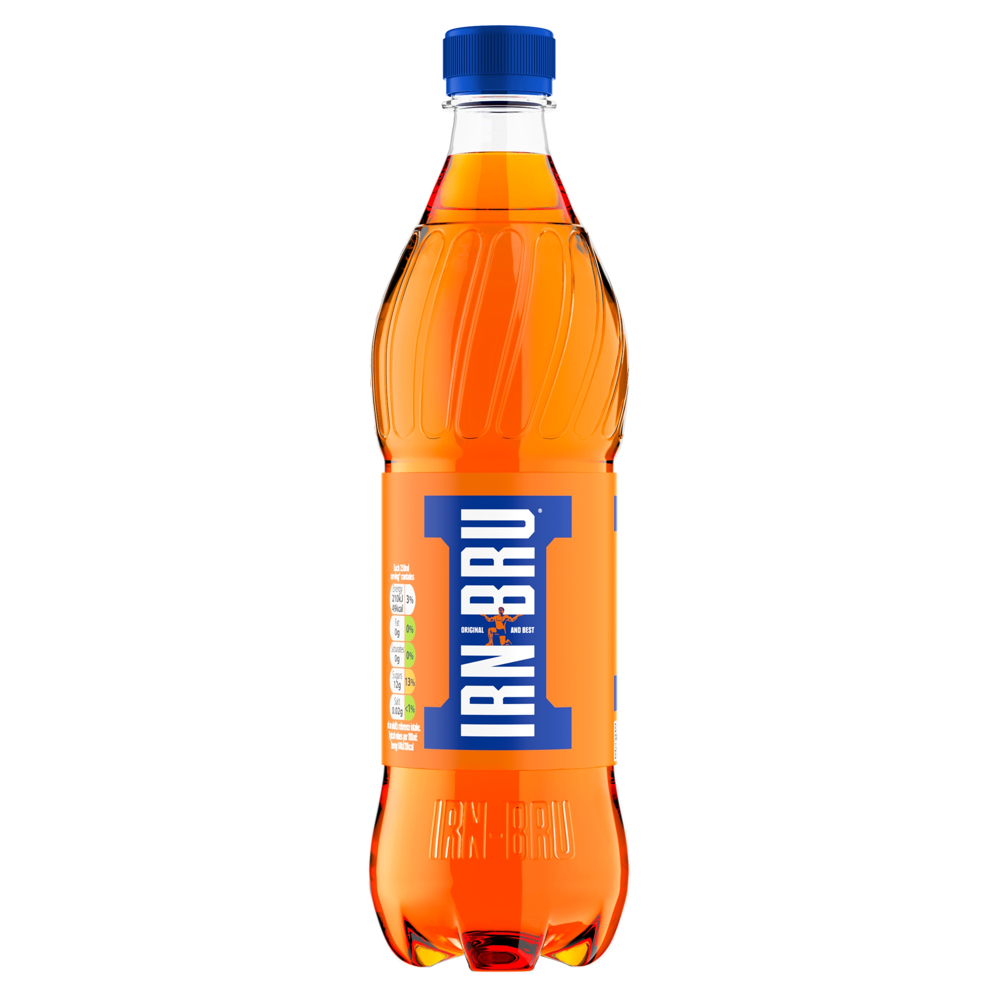
IRN-BRU

Slide 13
The most popular English deserts

Slide 14
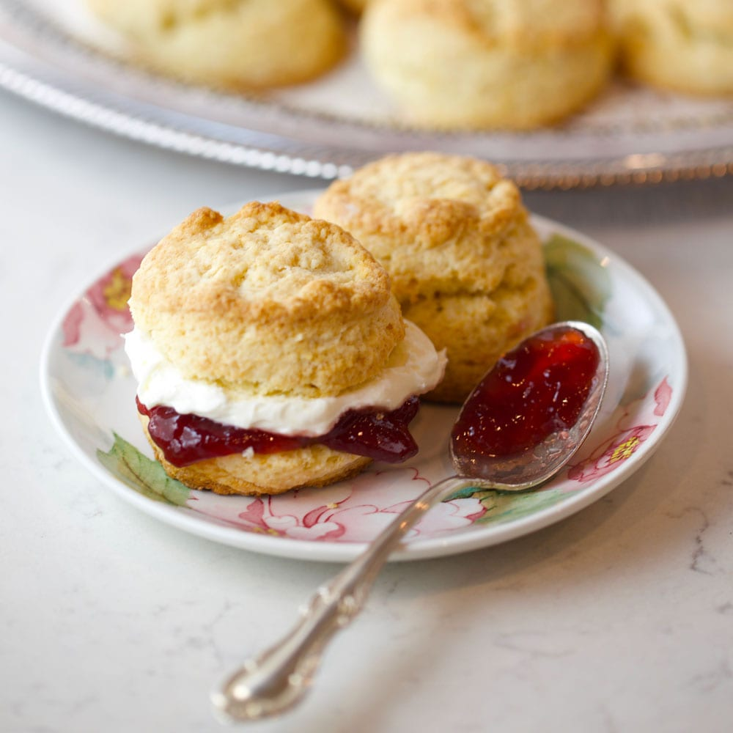
Scones with clotted cream and jam

Slide 15
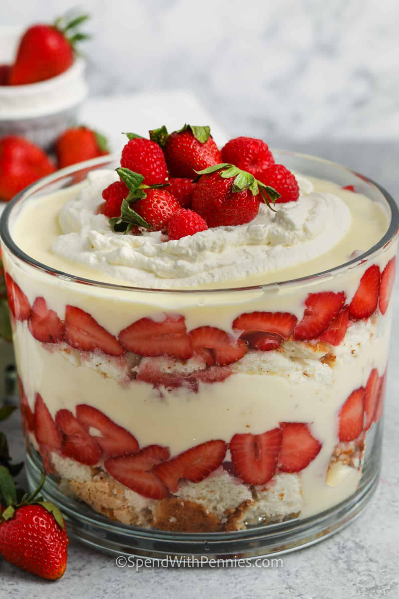
trifle

Slide 16
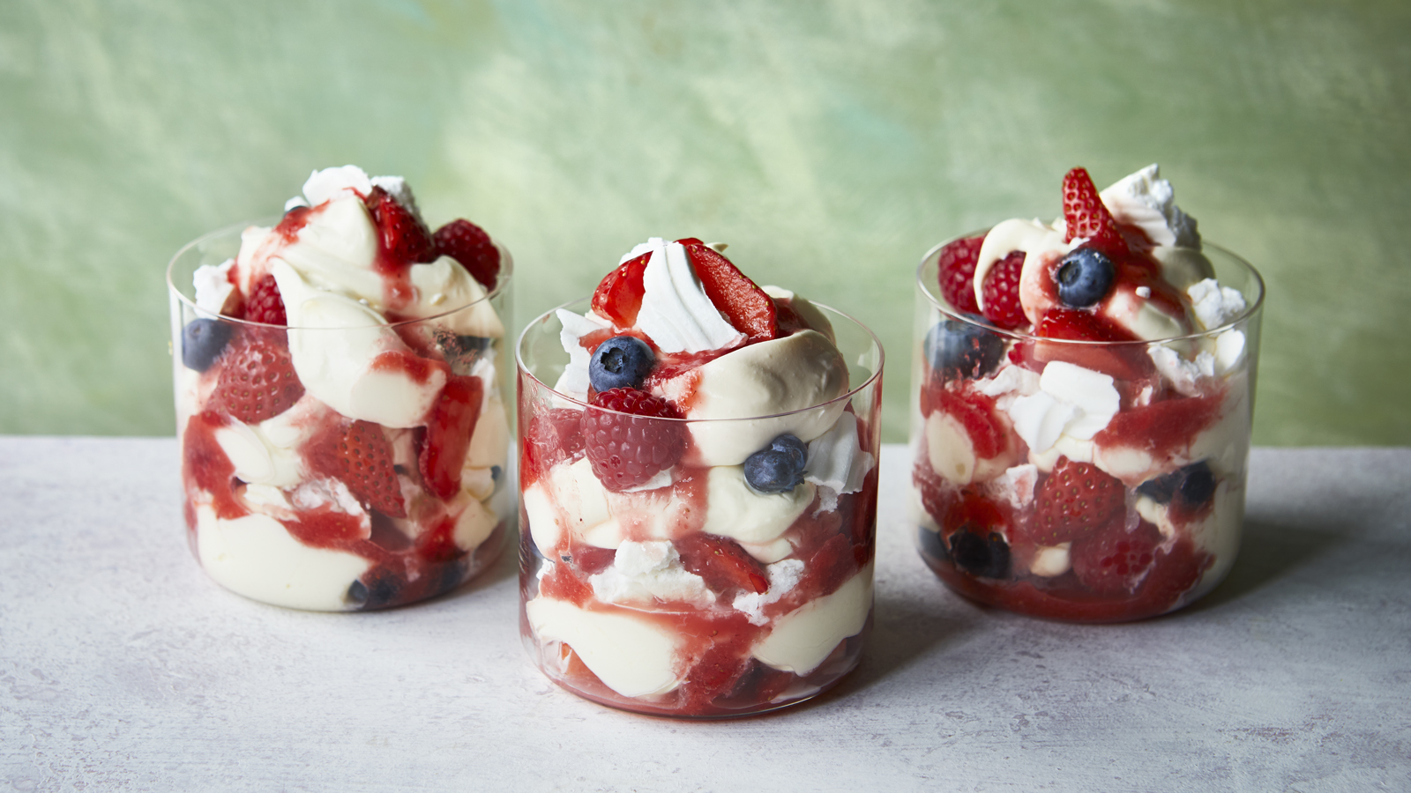
Eton mess

Slide 17
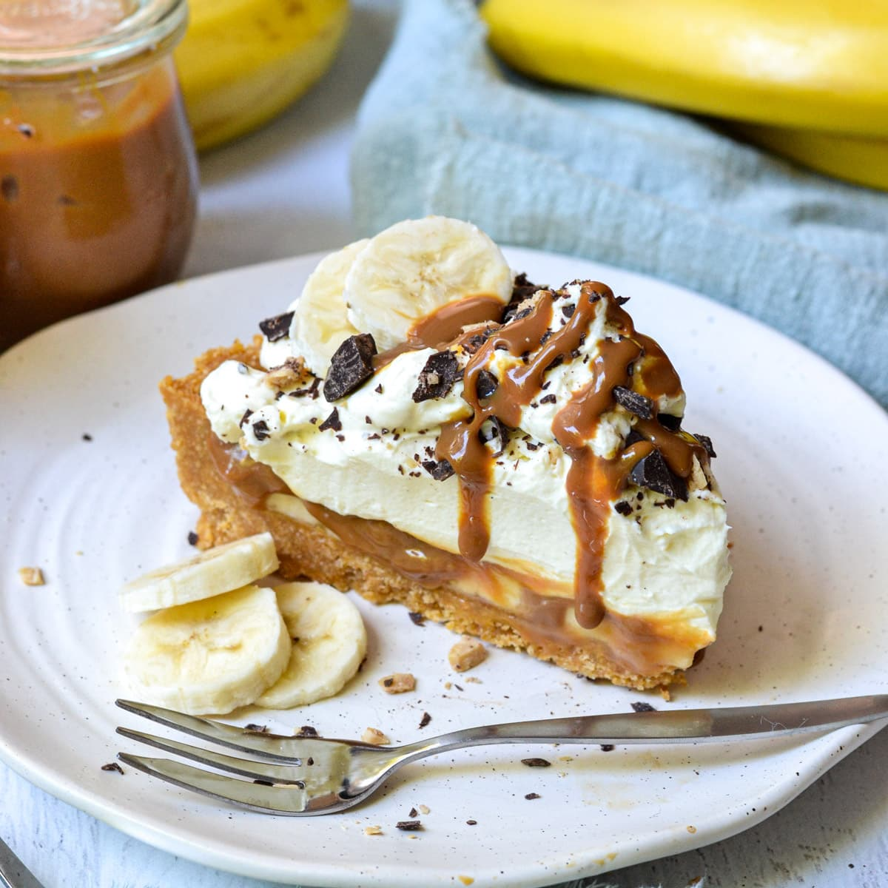
Banoffee pie

Slide 18
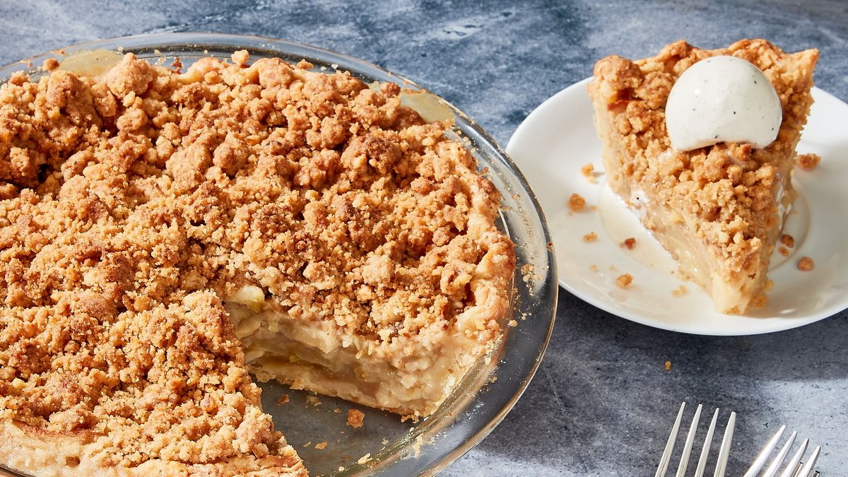
Apple crumble

Slide 19
Jaffa cake

